Slide 1
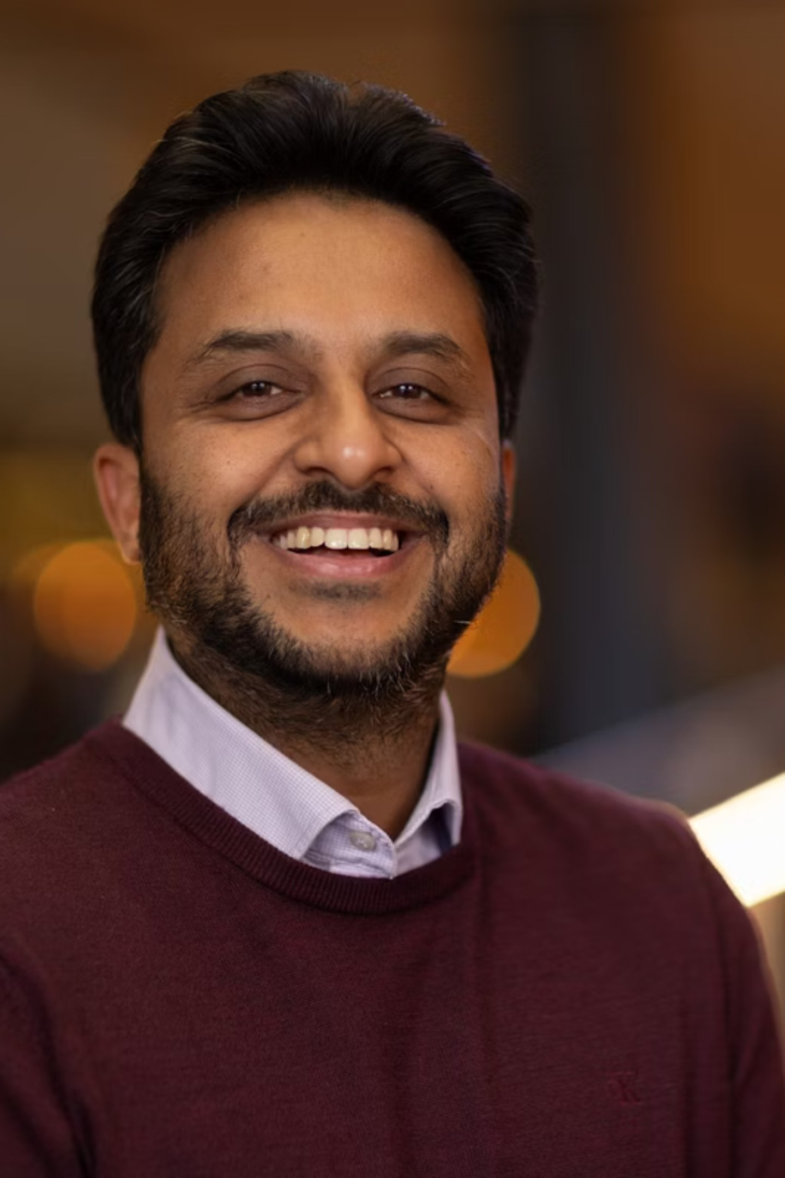


Breaking Mental Models
The story of Dr. Ankit Agarwal — educator, researcher, and lifelong learner whose journey from India to the world stage is defined by resilience, curiosity, and the belief that every challenge presents an opportunity for growth.

Slide 2
About Me — Biography
I am Dr. Ankit Agarwal, and my journey into education began at the tender age of five. Growing up in India, I was captivated by the titles held by my relatives—Doctors, Engineers, Advocates—and I found myself fascinated by the respect and admiration these titles commanded. At that young age, I dreamed of earning a title of my own, believing that education was the key to unlocking my future. However, like many children, I found traditional schooling a bit tedious and much preferred playing cricket. In the 1990s, I, like countless other children, idolised cricket legends such as Sachin Tendulkar and Don Bradman. Their humble demeanour and relentless passion for the game inspired me.
I wanted to emulate their success on the field, and while I considered myself above average, I never quite reached the heights I aspired to. This dream was further complicated by the passing of my grandparents, who were incredibly close to me. Their loss was profound and prompted me to leave India, feeling as though I was walking away from my dreams and the cricketing opportunities that once seemed within reach.
My journey took me to Dublin, Ireland, where I pursued a Diploma in Business Studies and later a Bachelor's in Management Information Systems and Management Accounting. Upon arriving in Ireland, I faced significant struggles, juggling multiple jobs to support myself. I transitioned from overnight security work to university classes, then to afternoon shifts at a petrol station, and even delivered food for local restaurants—all while maintaining a 97% attendance record at university to keep my visa valid. The hustle was relentless, and I often changed clothes in the car between jobs, but I was determined to succeed.
After my time in Ireland, I moved to the UK to pursue a Master's in Computer Systems and Software Engineering. I landed my first full-time job at PC World in Maidstone, Kent, and eventually moved to the US on an H1B visa. Unfortunately, I was duped by a company there, which led me to sue them. I fought the case while providing depositions via Skype from India, ultimately winning and seeing the company closed down. While I had to give 80% of my winnings to my wonderful lawyers who fought for me, it was a significant victory that showcased my resilience.
In pursuit of a new direction, I applied for permanent residency in Australia, successfully securing it within six to nine months. This pivotal moment led me to reach out to Dr. Peter Sandiford at the University of Adelaide, hoping he would supervise my PhD thesis. After waiting over a year for a response, I decided to take matters into my own hands. I flew to Australia for a day, determined to meet him in person and discuss my aspirations. Although I ultimately realised I needed to complete another Master's degree, this experience ignited a passion for academia that I hadn't fully recognised before.
Upon arriving in Adelaide, I lived in a hostel called Blue Galah on King William Street, where I had little money as I searched for jobs. To cover my rent, I took on tasks like making beds and cleaning toilets, receiving just a bowl of rice in the evenings. Despite the hardships, I found joy in the camaraderie of fellow backpackers, who appreciated my cooking and shared in the experience of learning together. I applied for over 350 jobs, securing only four interviews and facing numerous rejections. One setback included failing my driving test, which prevented me from securing a job I had hoped for. However, Matthew Giles offered me an alternative job in door-knocking, which marked the beginning of my career in Adelaide.
Throughout these struggles, I learned that each challenge was a small success step, shaping my resilience and determination. In hindsight, these experiences, while difficult, paved the way for my eventual achievements. In 2021, I secured my first lecturing position at the University of Adelaide, marking the beginning of a new chapter in my career. My story is one of resilience, curiosity, and the belief that every challenge presents an opportunity for growth. Education is not just about acquiring knowledge; it's about connecting with others, sharing experiences, and growing together.
Academic Qualifications
Doctor of Philosophy (Ph.D.) — Business & Management
Master in Business Research (MBR) — First-Class/Distinction
Master in Science (MSc) — Computer Systems & Software Engineering (Merit)
2017–2021 | The University of Adelaide (Adelaide University since January 1, 2026), Australia
2015–2016 | The University of Adelaide (Adelaide University since January 1, 2026), Australia
2005–2006 | The University of Greenwich, London, U.K.
Awarded lifetime member of the Golden Key Honour Society
Bachelor of Arts (BA. Hons) — Management & Information Systems (Honours)
Diploma in Business Studies
2003 | Dublin Business School, Dublin, Republic of Ireland
2003–2005 | Dublin Business School, Dublin, Republic of Ireland
Awarded Liverpool John Moore's University (LJMU, UK) Degree
Certifications
Leadership Accelerator Program (LAP), the University of Adelaide Executive Education (2024–2025)
Professional Development Certificate — Enhancing learning with digital strategies in Australia and New Zealand, Tiddle, 17–20 March 2025
Psychosocial Safety (2024)
PhD Oral Examination (2024)
Encouraging HDR Industry Engagement (2024)
Working with Integrity, Australia (2024)
Cyber Security Mandatory Learning, Australia (2024)
Understanding Power Dynamics and Close Personal Relationships, Australia (2024)
Real Response Certificate for First Aid, Basic Emergency Life Support & Cardiopulmonary Resuscitation, Australia (2023)
Sexual Harassment & Sexual Assault – What are the drivers and how can staff respond (2023)
Conflict of Interest (2023)
Management Education and Learning Writers Workshop, MED Division, @ Academy of Management Conference (2023)
Statement of Attainment (2023): HLTAID009 Provide cardiopulmonary resuscitation; HLTAID010 Provide basic emergency life support; HLTAID011 Provide First Aid
Corporate Cup – Certificate of Merit (2023)
Session Chair — Curriculum Design of an Inter-disciplinary Hands-on Social Innovation Program @ Academy of Management Conference, Seattle, United States, 5–9 August (2022)
Corporate Cup – Certificate of Merit (2022)
Professional Development of Emerging Teacher-Scholar, MED Division, @ Academy of Management Conference (2022)
ADEPT – Designing Blended Learning (2022)
Life Saver – Basic Life Support, India (2012)
CISCO Certified Network Associate (CCNA), Cisco, USA (2009–2012)
Computer Language – C, C++, Oracle, Java, J2EE, India (2002–2008)
Computer Knowledge, Institute of Electronics, India (1994–1996)

Slide 3




Research Interests & Teaching Philosophy
1. Psychosocial Safety
2. Student-Centered Experiential Learning
Exploring challenges individuals face in voicing their opinions in environments where psychological safety is crucial.
Investigating how social environments foster psychological safety, allowing for open expression without fear of criticism.
Emphasizing the importance of participation in conversations, contributing to a sense of belonging.
Examining the transition students face from school to university, particularly those without prior work or managerial experience.
Analyzing cultural shock during this transition and its effects on mental health.
Utilizing personal and family experiences to help students relate organizational behaviors to familiar relationships.
3. Dialogical Method of Research
4. Creative Writing and Theory Development
Advocating for engaging approaches in presenting research findings, moving away from traditional literature reviews.
Introducing the Imaginative Integrated Dialogical Approach (IIDA) to create dynamic narratives using direct quotes.
Enhancing understanding and encouraging deeper engagement with research material.
Fostering a keen interest in creative writing, including poetry, to extend current theories related to leadership, teamwork, and culture.
Seeking to explore new topics and innovative approaches within the fields of family business, HR, and AI.
Future Research Directions
Psychosocial Safety and Employee Motivation
Cognitive Development and Decision-Making Skills
Focus Area: Investigating the relationship between employee motivation and dissatisfaction within organizations, particularly exploring why employees choose to leave despite feeling motivated.
Focus Area: Applying the SCEL method to enhance cognitive abilities and decision-making skills among students in schools and higher education.
Key Insight: The term "demotivation" is viewed as an absurd concept; instead, the focus is on dissatisfaction that leads employees to seek opportunities elsewhere. This research aims to uncover the underlying motivations that drive this behavior.
Objective: To create a learning environment that not only prepares students academically but also equips them with the skills necessary to navigate complex organizational contexts.
Methodology: Utilizing the Student-Centered Experiential Learning (SCEL) method to further develop insights into psychosocial safety. This approach can be adapted for training employees, fostering a culture in which they feel valued and engaged.
Teaching Philosophy
Student-Centered Approach
This philosophy prioritizes the needs and experiences of students in the learning process. By focusing on what students bring to the classroom, educators can create a more engaging and inclusive environment. This approach encourages active participation, allowing students to take ownership of their learning and contribute to discussions, making the classroom a collaborative space.
Student-Centered Experiential Learning (SCEL)
The SCEL method emphasizes the importance of experiential learning tailored to the unique needs of each student. This approach involves integrating real-world experiences into the curriculum, helping students connect theoretical concepts with practical applications. SCEL focuses on the transition students face when moving from school to university, particularly for those without prior work or managerial experience. By addressing the cultural shock that can occur during this transition, SCEL aims to enhance students' mental health and academic performance. Utilizing personal and family experiences, SCEL helps students relate organizational behaviors to familiar relationships, making higher education more accessible and relatable.
Critical Thinking and Dialogue
Promoting critical thinking involves encouraging students to question assumptions and engage in meaningful discussions. This creates an environment where diverse perspectives are valued, fostering deeper understanding and retention of material. Utilizing a dialogical method in teaching allows for dynamic conversations around course content, transforming traditional lectures into interactive discussions that enhance engagement.
Supportive Learning Environment
Creating a psychologically safe space is crucial for student success. In such an environment, students feel comfortable voicing their opinions and ideas without fear of criticism. This sense of belonging is essential for their overall well-being and academic performance, as it encourages them to participate actively and contribute to discussions.
Continuous Improvement
Committed to ongoing professional development, educators should adapt their teaching methods based on student feedback and emerging educational practices. This commitment to improvement ensures that teaching remains relevant and effective, ultimately benefiting students' learning experiences.
Volunteering Work
Current Involvement
Human Intelligence Movement, United States of America (2024–Present) — Founding Member (Jun 2024 – Present)
Friends of the Library, South Australia (2024–Present) — Vice-President (Sept 2024 – Present)
Our mission is to ensure that all students possess the skills necessary to thrive and succeed in an AI-driven world. We raise awareness about the importance of building career readiness for this new landscape. Our community, composed of students, educators, businesses, and nonprofits, collaborates to address practical challenges and drive meaningful change through educational policy reform. I am actively engaged in developing and implementing programs that enhance emotional intelligence, creativity, and personal growth. My involvement includes facilitating workshops, mentoring participants, and collaborating with other educators to create innovative learning experiences. This role allows me to contribute to a global initiative focused on fostering human potential and creating a more compassionate society.
Lead and implement programs that promote library resources and services.
Advocate for funding and support at local and state levels.
Foster partnerships with community organizations to expand outreach.
Engage and grow membership to strengthen community ties.
Organise and arrange seminars, webinars, and events throughout the year to educate and connect the community.
Collaborate with the board on strategic planning and governance.
As a dedicated member, I support the University of Adelaide Library through various initiatives, including organising fundraising events, promoting literacy programs, and coordinating community outreach activities. My efforts aim to enhance library services and resources, making them more accessible to students and the broader community. I also work on initiatives that encourage reading and lifelong learning, contributing to a culture of knowledge sharing.
Rotary Club of Adelaide, South Australia (2023–Present) — Honorary Secretary (Jun 2025 – Present)
DreamCricket, Australia (2023–Present) — Board Member & Director (Mar 2024 – Present)
Attend district training assemblies and district conferences, ensuring alignment with Rotary's mission.
Review and update the club's strategic plan and maintain accurate club records and member lists using My Rotary or the club management system.
Ensure the club has the latest Rotary governance documents for reference.
Coordinate with the treasurer to ensure timely payment of club invoices.
Serve on the club board and administration committee, contributing to decision-making processes.
Collaborate with the membership committee to manage membership leads effectively.
Take minutes at club and board meetings and club assemblies, maintaining clear records of discussions and decisions.
Update club and officer information for the online Official Directory and Rotary's records.
Manage club correspondence, including responding to emails and sending official notices and invitations.
Maintain promotional items, name badges, and materials used at meetings and events.
Preserve the club's historical records and write an annual report for the club at the end of the Rotary year.
Assist the club president, treasurer, and committees in their respective roles.
Focused on promoting cricket for children with special needs in schools across South Australia, I work with relevant agencies and organisations to ensure the continuity of cricket programs for these children. Heavily involved in organising and facilitating inclusive cricket clinics and events, I develop tailored training programs that accommodate various abilities, fostering an environment of teamwork and social interaction. I work closely with families and educators to ensure that children can participate fully, helping to build confidence and physical fitness while enjoying the sport.
As a member of this esteemed community service organisation, I actively participate in local and international projects that address pressing social issues. My responsibilities include organising fundraising events, collaborating with other organisations for community development, and engaging in hands-on service projects. Through my involvement, I help promote peace, health, and education, making a positive impact on both local and global communities.
Past Involvement
South Australian State Emergency Services (2025)
During my time with SASES, I was actively involved in emergency response efforts, participating in training exercises and real-life emergency situations. My role included assisting in disaster preparedness initiatives, educating the community about safety measures, and providing support during emergencies such as floods and storms. This experience enhanced my leadership skills and commitment to community safety.
Australian Electoral Commission (May 2025)
I played a crucial role in supporting the electoral process, focusing on promoting civic engagement and ensuring that elections were conducted fairly. I was trained in the Officer-In-Charge 4–6 Issuing Points role and deployed as an Electoral Officer 5 Polling Assistant. My responsibilities included assisting with voter registration drives, providing information to the public about the electoral process, and helping to organise community forums to encourage voter participation. This experience deepened my understanding of democratic processes and the importance of civic responsibility.
The University of Adelaide – Global IQ Connect (2017–2021)
As a dedicated volunteer, I worked to connect international students with local communities, helping them navigate their new environment. My involvement included organising cultural exchange events, providing mentorship, and facilitating workshops on adapting to life in Australia. This role allowed me to foster inclusivity and support the diverse needs of international students.
The University of Adelaide – Experience Adelaide (2019)
I participated in programs aimed at introducing new students to the cultural and social aspects of Adelaide. My responsibilities included organising tours, coordinating activities that showcase local culture, and helping students integrate into the community. This role was instrumental in enhancing the university experience for many students.
Cancer Aid Society – Fundraiser (Jan 1995 – Dec 1998)
I led various campaigns focused on alleviating the suffering of cancer patients and raising awareness about cancer prevention. My involvement included organising fundraising events, collaborating with healthcare professionals to provide resources, and developing awareness campaigns that educated the public about cancer-related issues. This experience was deeply fulfilling and reinforced my commitment to community health and support.

Slide 4

Professional Experience
CURRENT ROLE
Senior Manager – Education Services
South Australian Certificate of Education (SACE) Board of South Australia — Jan 2026–Present
Provide strategic leadership and oversight of the SACE Board's curriculum, assessment, recognition, and quality assurance frameworks.
Ensure alignment with the SACE Board's strategic plan and legislative obligations.
Lead systemic education change initiatives and manage a team of Faculty Managers.
Oversee significant program, budget, and policy outcomes.
Develop strategic partnerships across government, schools, industry, and education partners.
Foster a strong organisational culture within Education Services and the broader organisation.
Lead major education change initiatives to innovate and reshape curriculum and assessment.
Contribute to education thought leadership and represent the SACE Board at various levels.
Inspire purpose and achievement within the Education Services Group by aligning strategy with priorities.
Oversee curriculum and assessment projects, applying project management and quality standards.
Lead the SACE Board's approach to recognition (including VET) policy and systems.
Implement effective stakeholder management strategies to influence key education outcomes.

Slide 5





Professional Experience (Continued)
Senior Credit Sales Associate (Promoted Internally)
Credit Sales Associate
OurMoneyMarket Pty Ltd., Australia — Jan 2021–Nov 2021
OurMoneyMarket Pty Ltd., Australia — Aug 2019–Jan 2021
Assisting with the credit and collections operations in the Company; with investor relations; in establishing loan origination channels and in identifying opportunities to optimise revenue for the business, whether that is through credit related and user data.
Assisting senior management with capital related matters, including but not limited to, preparation of presentations and pitch packs, loan performance analytics, assisting with the arrangement and structuring of structured credit deals and funding facilities.
Reviewing and commenting on legal documentation and preparation of investor reporting.
Assisting in reporting to the Trustee and Custodian on the performance of the OurMoneyMarket Investment Trust.
Manage inbound and outbound sales calls with all OurMoneyMarket customers.
Training staff on credit sales for performance improvement.
Assisting with the credit and collections operations in the Company; with investor relations; in establishing loan origination channels and in identifying opportunities to optimise revenue for the business, whether that is through credit related and user data.
Assisting senior management with capital related matters, including but not limited to, preparation of presentations and pitch packs, loan performance analytics, assisting with the arrangement and structuring of structured credit deals and funding facilities.
Reviewing and commenting on legal documentation and preparation of investor reporting.
Assisting in reporting to the Trustee and Custodian on the performance of the OurMoneyMarket Investment Trust.
Manage inbound and outbound sales calls with all OurMoneyMarket customers.
Design Consultant
Promotions Representative
Australian Outdoor Living Pty Ltd., Australia — Jul 2017–Aug 2019
Bramalco Pty Ltd., Australia — May 2015–Jul 2017
Provide Consultancy to Domestic Clients on Fibre Glass Swimming Pools.
Administrative Duties, such as, developing contract & agreements.
Developing Architectural Drawings and Conducting first level of site inspection.
Promote company's products to domestic and business clients.
Locates or proposes potential business deals by contacting potential partners; discovering and exploring opportunities.
Develops negotiating strategies and positions by studying integration of new venture with company strategies and operations; examining risks and potentials; estimating partners' needs and goals.
Senior Manager – Business Development
Manager – Business Development
Freyr Inc., the USA — Feb 2014–Oct 2014
HTC Global Services Inc., India — Jan 2013–Dec 2013
Promoting the company's products and technical support capabilities.
Identifies trendsetter ideas by researching industry and related events, publications, and announcements; tracking individual contributors and their accomplishments.
Screens potential business deals by analysing market strategies, deal requirements, potential, and financials; evaluating options; resolving internal priorities.
E-Learning and E-Publishing Lead Generation, prospecting, Qualification through databases, newsletters, alerts & research, social networking and advance Google search option.
Proposal Submission and Closure of Opportunities, with the help of operations team.
Acquiring and updating knowledge of employers' and competitors' services, and market conditions visiting regular and prospective client businesses to establish and act on selling opportunities assessing customers' needs and explaining the goods and services which meet their needs.
Assistant Manager – Inside Sales
Senior Sales & Marketing Manager
Integra Software Services Pvt. Ltd., India — Feb 2012–Jan 2013
Elation Softnet Pvt. Ltd., India — Mar 2008–Jul 2011
Responsible to meet the revenue targets as per overall business plans of the company in relation to E-Learning & E-Publishing environment.
Customer intelligence and market trends Planning, forecasting and reviewing. Preparing sales plans by customer-wise accounts.
Create/facilitate campaigns/promotional projects for department to meet revenue goals.
Developing Policies and Management Information System Model for enhancing growth of the company.
Designing systems/procedures for Change Management in Company operations entailing mapping business processes and studying work-flow to design solutions.
Conducting project feasibility studies and preparing reports to assess the financial viability, predictable cash flow & growth opportunities for projects and business lines.
Business Sales Advisor
Static Security Officer
PC World, DSGi, London, UK — Oct 2005–Feb 2008
Securway Security Ltd, Dublin, Republic of Ireland — May 2003–May 2005
Accounts Management and supervising a team of 25 people, providing training regarding, IT, sales and marketing and customer service techniques.
Maximize Sell-in Domestic and Business Products, communicate schemes and other promotions to maximize sales and prepare Plano-grams for correct placement in outlets.
Support Assistant Managers and General Manager in planning activities and Identify slow moving models and innovate ideas to enhance the speed.
General security duties.
Dealing with emergencies and liaising with Gardaí if necessary.
Report all incidents, accidents and emergencies.
Regular Health & Safety Checks of all areas.
To provide an open and consistent communication interface between the Client and Management.
To be fully aware of all emergency and evacuation procedures.
Other reasonable duties that may be assigned from time to time.
Fully adhere to onsite procedures and policies.
Contract Assignments
Officer-In-Charge 4–6 Issuing Points, Electoral Officer 5 (deployed as Polling Assistant) — May 2025
Program Director – Honours — Dec 2023–Mar 2024
Academic Mentor — Wirltu Yarlu Academic Mentoring Program 2018–2019
Electoral Election Commission (AEC), Australia
Adelaide Business School, Australia
University of Adelaide, South Australia
Business Development Head — Aug 2011–Feb 2012
System Analyst — Jan 2009–Apr 2009
Tranquil Minds, SIMHANS Pvt. Ltd., India
Halcyon Virtual Technology Group, USA

Slide 6
Academic Experience
Editorial & Review Roles
Teaching Roles at University of Adelaide
Editorial Review Board Member
Early Career Researcher
Lecturer in Management — Nov 2021–Feb 2026
Program Director — Bachelor of Business (Management) — Dec 2022–Dec 2025
Journal of Management Education (JME) — Mar 2026–Present
Journal of East European Management Studies (JEEMS) — Apr 2025–Present
Lecturing, Course Coordinating, Academic Tutoring and Workshop Facilitating: People & Organisations (Postgraduate, also offered to MBA – Emerging Leaders) – 60+ Students; Managing Organisations & People (Undergraduate) – 150+ Students; Open University of Australia – Managing Organisations & People.
Responsible for working with UniSA Academics in the Adelaide University (AU) Program and Curriculum Development. Planning and coordinating the teaching of courses in the Program. Developing, updating and/or overseeing Program design and course(s). Coordinating the teaching team including professional staff, academic staff, titleholders and guest lecturers. Providing approval of enrolment waivers to course restrictions.
Board Member and Associate Reviewer
Academic Reviewer – ABDC ranked Journals
International Journal of Doctor Studies (IJDS) — May 2024–Present
Dec 2017–Present
Guest Lecturer (Business School)
Noida Institute of Entrepreneurship (NIE), India — 2011. Management and Employability.
Course Coordinator (Business School) — Jan 2019–Feb 2026
Sessional Lecturer/Academic Tutor/Workshop Facilitator — Feb 2016–Nov 2021
People & Organisations (Postgraduate, also offered to MBA – Emerging Leaders) (from February 2021 onward); Managing Organisations & People (Undergraduate); Managing Across Cultures III.
Post graduate course – People & Organisation; Undergraduate courses – Managing Organisations and People, Organisational Behaviour II and Managing Across Cultures III.
Supervising Higher Degree by Research (HDR) Studies
Completed
MPhil: Ms Aya Jabareen
PhD: Mr Anas Al-Shamleh
"Deconstructing the Meaning of Psychological Safety" (2023–2025): Principal Supervisor with Dr Peter John Sandiford (Co-Supervisor)
"Madness of the Crowds: How Social Media is Reshaping Politics, Enhancing Democracy and Political Engagement" (2023–2025): Principal Supervisor with Dr Cate Jerram
Ongoing
PhD: Ms Ngoc Hanh Thi Tran
PhD: Mr Robert Armstrong
PhD: Ms Linda Magin
"Network Orchestration in Modern Slavery Mitigation Practices in the Supply Chain" (2023–2026): Principal Supervisor with Associate Professor Sajad Fayezi and Dr Maryam Zomorrodi
"Business Strategic Management in the 21st Century – Is the Primary Focus Still on Shareholder Value?" (2023–2027): Principal Supervisor with Mr David Pender and Dr Peter John Sandiford
"Exploring work-life enrichment experiences among women in construction trades: An Interpretative Phenomenological Analysis Study" (2023–2030, Part-time): Principal Supervisor with Dr Peter John Sandiford
PhD: Ms Jean Marie-See
PhD: Ms Maria Neledva
"An exploration of the psychological contracts of academics in higher education: The South Australian context" (2025–2029): Principal Supervisor with Christian Hoyer, Dean Wilkie and Peter Sandiford
"Exploring Learning Theories within Higher Degree Marketing Courses" (2024–2028): Co-Supervisor with Dr Dean Wilkie
HDR Student Awards Under My Supervision
Ms Maria Neledva
Ms Ngoc Hanh Thi Tran
Ms Linda Magin
Best Presentation Award at the Western Sydney University International Doctoral Business Research Conference, 2024
Best Development Paper Award at the British Academy of Management Conference, 2024
Community Collaboration Award at the Arts, Business, Law and Economics (ABLE) Higher Degree by Research Conference, 2025
Research Excellence Award at the Arts, Business, Law and Economics (ABLE) Higher Degree by Research Conference, 2025

Slide 7
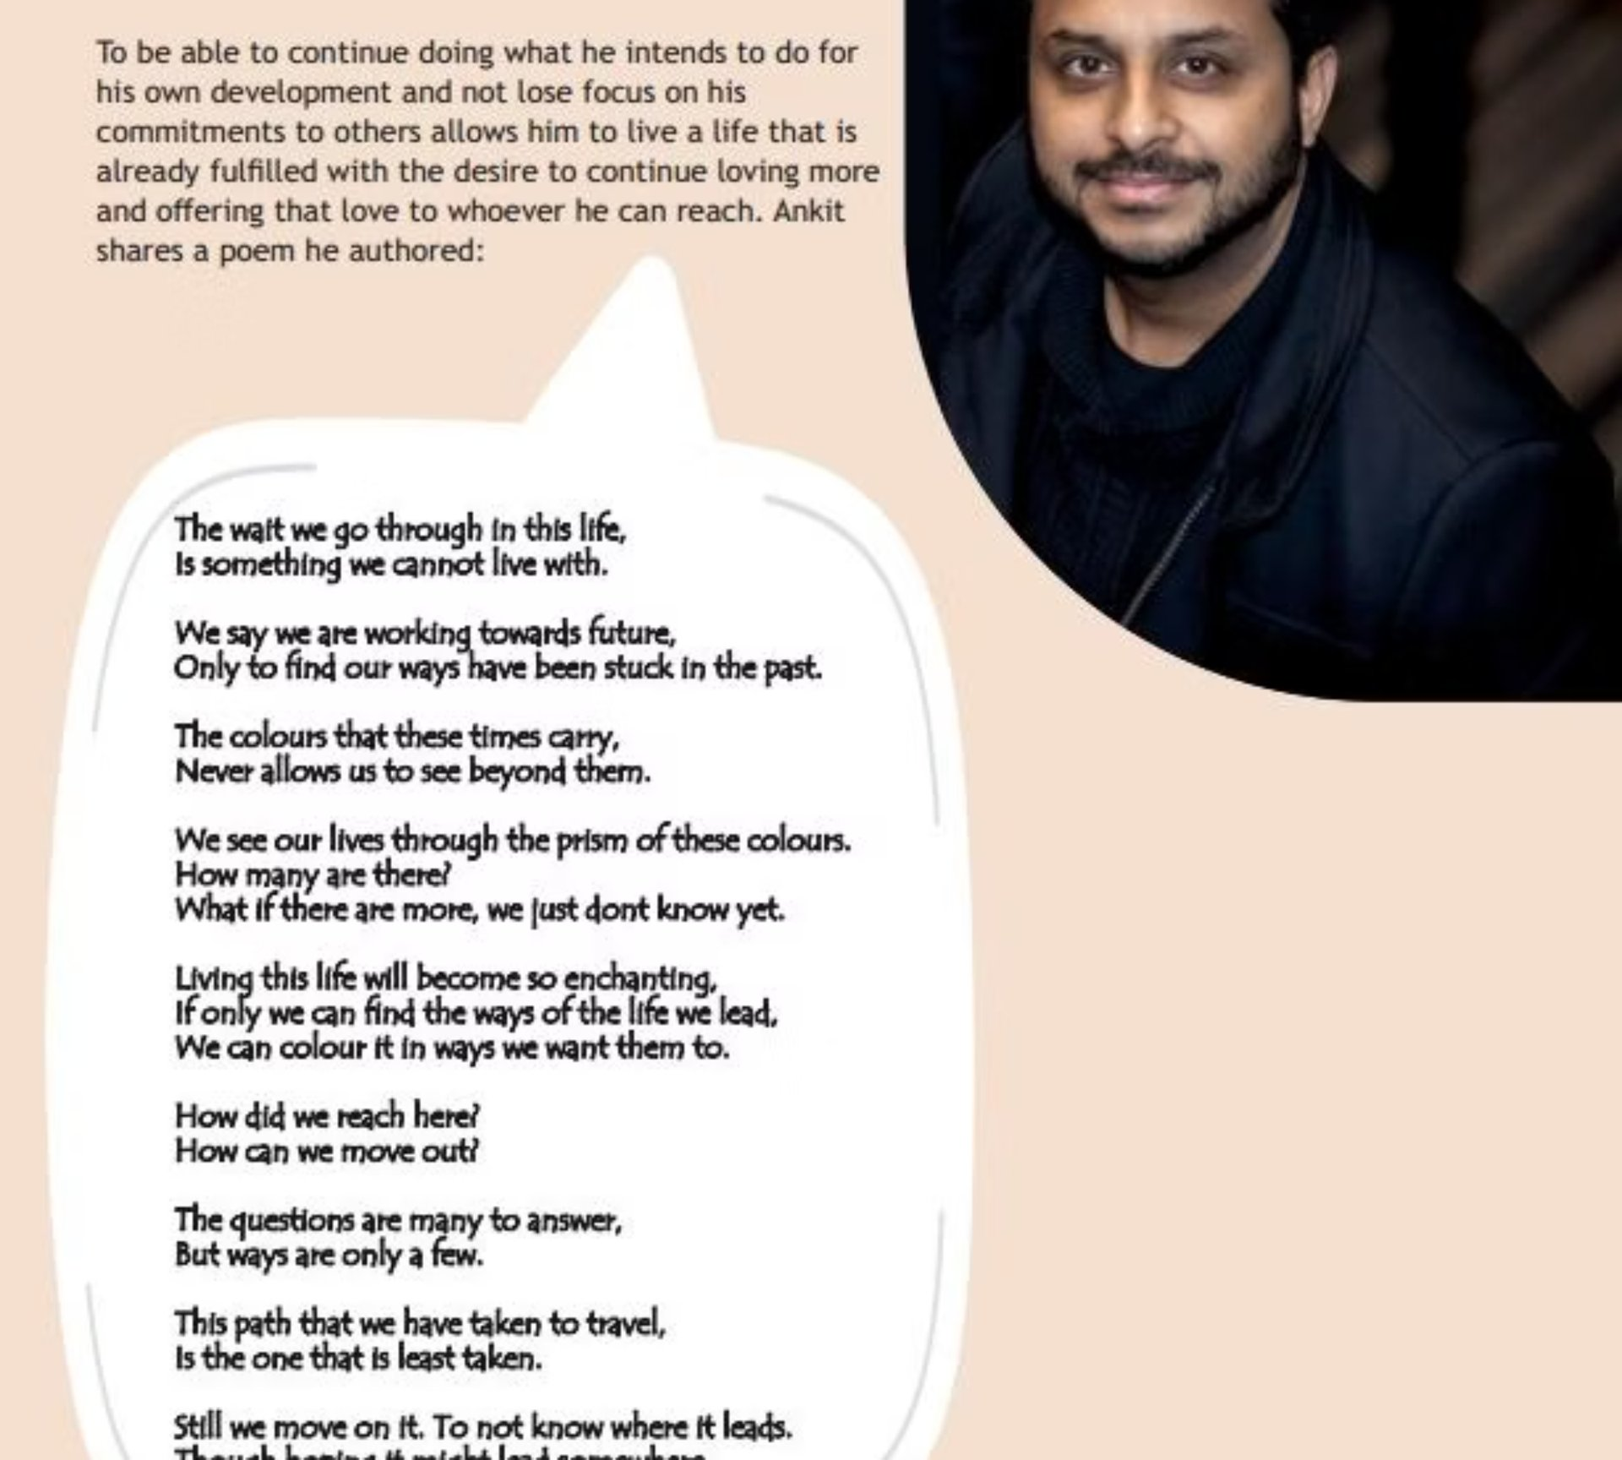

Research Publications
Dr. Agarwal's research spans a wide range of disciplines — from human resource management and psychosocial safety to leadership, family business, and creative writing. Below is a comprehensive overview of his published and presented scholarly work.
People & Organisations
Creative Reflexivity
Leadership & Teams
Teaching & Learning
These four pillars reflect the breadth and depth of Dr. Agarwal's scholarly contributions, connecting idiographic focus in organisational behaviour, innovative pedagogy, psychosocial safety and global business perspectives.

Slide 8
Research Publications — HRM & Reflexivity
1. Human Resource Management (HRM)
2. Reflexivity
Ukil, M.I., Ullah, M.S., Islam, M., Tariq, H., & Agarwal, A. (2024). Stress and satisfaction while working from home during COVID-19: The role of personal and job resources. South Asian Journal of Human Resources Management, in print. https://doi.org/10.1177/23220937241246325.
Agarwal, A. & Sandiford, P.J. (2021). Fictionalizing dialogue: Interpretative Phenomenological Analysis in organizational research. Qualitative Research in Organizations and Management, 16(1), 218–236. https://doi.org/10.1108/QROM-01-2020-1885.
Agarwal, A. (2024). Making reflexivity explicit. In P.J. Sandiford and S. Schuhrer (Eds.), Exploring Research Methodology and Research Design: Doing Research Across the Business Discipline, Edward Elgar: UK.
Nichols, E., Middleton, S., Agarwal, A., & Callaghar, L. (2024). Crafting Developmental Reviews. Management and Organizational Behavior Teaching Society Oceania, PDW. University of Auckland, New Zealand, January 29–31, 2025.
Agarwal, A. (2024). Reflexive and Conversational Literature Reviews: Imaginative Integrated Dialogue Approach. Academy of Management Conference, Alchemy of Qualitative Research (AQR), PDW, Chicago, August 10, 2024.
Invited to present a Masterclass in Advanced Learning for Professionals on "Learning Organisational Behaviour: Developing a Reflexive Mindset", the University of Adelaide, Australia, October 8, 2024. https://www.adelaide.edu.au/study/postgraduate/advanced-learning-for-professionals.

Slide 9
Research Publications — Health & Modern Slavery
3. Health
4. Modern Slavery
George, G., Saravanakrishnan, V., & Agarwal, A. (2023). Health Informatics and its Contribution to Health Sectors. In M. Abouhawwash, S. Tanwar, A. Nayyar, & M. Naved (Eds.), Innovations in Healthcare Informatics: From interoperability to data analysis, The Institution of Engineering and Technology (IET).
Fayezi, S., Tran H.N.T., Zomorrodi, M, & Agarwal A. (2024). Leveraging network orchestration to address modern slavery risks in the supply chain. In Reference Module in Social Sciences, International Encyclopedia of Business Management, Elsevier.
Tran, N. H. T., Fayezi, S., Zomorrodi, M., & Agarwal, A. (2024). Leveraging network orchestration to address modern slavery risks in the supply chain track: Operations, logistics and supply chain management. British Academy of Management 2024 Conference, Nottingham Trent University, Nottingham: UK.

Slide 10
Research Publications — Conceptual Work, Leadership & Motivation
5. Conceptual Work — Leading/Leadership
6. Motivation
Agarwal, A. (2024). Chapter 00176: Shepherding Engineering Leadership: Leading With a Combination of Timeless Wisdom and Modern Insights. In Reference Module in Social Sciences, International Encyclopedia of Business Management, Elsevier.
Maria N., Agarwal, A., & Wilkie, D. (2024). A conceptual exploration of motivation types as antecedents to subsequent tertiary learning outcomes. International Doctoral Business Research Conference, Western Sydney University, Australia, November 7–8, 2024.
Agarwal, A. (2024). Chapter 00177: 'Side-by-Side Leading': Leader-Follower Dynamics in the Organizational World of Artificial Intelligence. In Reference Module in Social Sciences, International Encyclopedia of Business Management, Elsevier.
Agarwal, A. (2023). Shepherding Engineering Leadership: A Combined Approach to Leading and Creating Employee Engagement. In: Marques, J. (eds) The Palgrave Handbook of Fulfillment, Wellness, and Personal Growth at Work. Palgrave Macmillan, Cham. https://doi.org/10.1007/978-3-031-35494-6_8.
Gulati, R., Agarwal, A., & Campbell, K. (2025). Nurturing an Agile Mindset for Leading International Teams in the Realm of Global Business. Academy of International Business 2025 Conference, Louisville, Kentucky, US.
Agarwal, A., & Hallo, L. (2023). Side-by-Side Leadership to rethinking the role of people and data in organizational decision-making. Leading and Managing in the Digital Era (LMDE) Conference, Athens, Greece, June 20–23, 2023.
Leonie, H., & Agarwal, A. (2023). Combining intuition and artificial intelligence in leadership decision-making: Why and how? Leading and Managing in the Digital Era (LMDE) Conference, Athens, Greece, June 20–23, 2023.

Slide 11
Research Publications — Teams, MBA & Creative Writing
7. Teams
8. MBA
9. Creative Writing
Agarwal, A. (2022). Managing Groups: Skills to Uncover the Pre-forming Stage and Distributing Roles. Academy of Management Proceedings (Vol. 2022, No. 1, p. 15389). Seattle, WA. Briarcliff Manor, NY 10510: Academy of Management.
Agarwal, A., & Hallo, L. (2024). Reflecting on the MBA degree: Waving a magic wand and/or grasping a nettle? Academy of Management Proceedings, Chicago: IL.
Sandiford, P., Agarwal, A., Cheesman-Dutton, N., & Neledva, M. (2022). Creative writing as scholarly business research: the contribution of a literary literature. Australia New Zealand Academy of Management, Gold Coast, Australia.
Agarwal, A., Sandiford, P., & Wells, S. (2019). Exploring the 'X Factor' to Excavate the Value of an MBA. Academy of Management Proceedings, 2019(1), p.18947. Boston, MA. Briarcliff Manor, NY 10510: Academy of Management.

Slide 12
Research Publications — Family Business & International Business
10. Family Business
11. International Business
Barbera, F., Shi, H. X., Agarwal, A., & Edwards, M. (2020). The Family That Prays Together Stays Together: Toward a Process Model of Religious Value Transmission in Family Firms. Journal of Business Ethics, 163, 661–673. https://doi.org/10.1007/s10551-019-04382-7 (FT50 Ranking).
Rammal, H.G., Rose, E.L., Gulati, R., Agarwal, A., & Wijewardhana, C. (2024). The Japan-India Comprehensive Economic Partnership Agreement Rhetoric and Reality. The Association of Japanese Business Studies, Seoul, South Korea.
Agarwal, A. (2022). Why 'but' and not 'and.' 5th Asia Pacific Family Business Conference 2022: "Family Business Models: Recovering from COVID 19", Perth, WA, September 28, 2022.
Gulati, R, & Agarwal, A. (2024). Transforming India: The "Make in India" Initiative. Academy of International Business Insights, PDW, Seoul, July 2, 2024.
Agarwal, A. (2025). Resurrecting first-generation entrepreneur's spirit: Immortalising founder to subsequent generations. Asia Pacific Family Business Symposium 2025, Kuala Lumpur Malaysia, September 27, 2025.
Agarwal, A. (2023). Where are we shifting: Towards Changing Mindset or ChangeMindset. International Conference on Sustainability and Social Entrepreneurship building a better India: Vision 2050, Symposium, Lucknow, Uttar Pradesh, India, October 5–7, 2023.
Richa, G., Hallo, L., Agarwal, A., & Campbell, K. (2023). Nurturing an Agile Mindset for Leading International Teams in the Realm of Global Business. Academy of International Business Oceania Conference, PDW, Adelaide, November 24, 2023.
Agarwal, A., Hallo, L., & Gulati, R. (2023). Enhancing Farmer Involvement in Grain Research and Decision-Making. Academy of International Business Oceania Symposia, Adelaide, November 24, 2023.

Slide 13
Research Publications — Teaching & Learning, Academia & Case Studies
12. Teaching and Learning & Academia
13. Case Studies
Agarwal, A. (2025). Organizational Behaviour Course with Reflective Thinking and Student-Centric Experiential Learning Approach. In M. Eklund & K. Graham (Eds.), Practical Applications of Experiential and Community-Engaged Learning Methods in Business: High-Impact Teaching Practices in Business Education (Vol 1), Edward Elgar: UK.
Agarwal, A. (2023). Case Study: Controlling, Uber. In J.R. Schermerhorn, D.G. Bachrach, P. Woods, F. Junaid, T. McKeown, & M.J. Co., Exploring Management, 1st Asia-Pacific Edition, John Wiley & Sons Australia, pp. 337–339.
Agarwal, A. (2025). What is Student-Centric Experiential Learning?. In M. Eklund & K. Graham (Eds.), Practical Applications of Experiential and Community-Engaged Learning Methods in Business: High-Impact Teaching Practices in Business Education (Vol 1), Edward Elgar: UK.
Agarwal, A. (2023). Case Study: Leading, Haigh's Chocolate. In J.R. Schermerhorn, D.G. Bachrach, P. Woods, F. Junaid, T. McKeown, & M.J. Co., Exploring Management, 1st Asia-Pacific Edition, John Wiley & Sons Australia, pp. 476–479.
Agarwal, A. (2025). Integrating Family Experiences and Business Concepts for Sustainable Student Development. In Ivanova, E., Rimanoczy, I., & Singhal, D. (Eds.), The Power of Arts-Based Pedagogies: Transforming Mindsets to Shape Our Future Routledge Series: Principles for Responsible Management Education (PRME).
Agarwal, A. (2023). Case Study: Organising, Foodland Supermarket Brand. In J.R. Schermerhorn, D.G. Bachrach, P. Woods, F. Junaid, T. McKeown, & M.J. Co., Exploring Management, 1st Asia-Pacific Edition, John Wiley & Sons Australia, pp. 306–309.
Agarwal, A. (2023). Case Study: Planning, Viterra Australia. In J.R. Schermerhorn, D.G. Bachrach, P. Woods, F. Junaid, T. McKeown, & M.J. Co., Exploring Management, 1st Asia-Pacific Edition, John Wiley & Sons Australia, pp. 209–211.
Sandiford, P., Agarwal, A., & Wells, S. (2019). Three Scholars at Work: Making Sense of the 21st Century Academy. In M. Antoniadou and M. Crowder (Eds.), Modern Day Challenges in Academia: time for a change, Edward Elgar: UK.
Agarwal, A. (2025). Bridging Personal Narratives and Business Concepts: Leveraging Familial Experiences to Make Students' Classroom Learning Sustainable and Actionable Beyond Earning a Degree. Higher Education Research Group Adelaide (HERGA) Conference, Flinders University, Bedford Park, Australia, September 30–October 1, 2025.
Agarwal, A. (2023). Teaching Critically and Reflectively: using Students' Family Lens to Teach Business and Management Concepts. 36th Australia New Zealand Academy of Management Conference, Wellington, New Zealand, December 5–7, 2023.
Agarwal, A. (2023). Teaching management practically: incorporating students' family experiences into management teaching. Management and Organisational Behavior Teaching Society, Jacksonville University, Florida.
Agarwal, A. (2023). The 'why' experience: using student's family experience as a lens to teach business courses. Management and Organisational Behavior Teaching Society Oceania, New South Wales, Australia.
Agarwal, A. (2022). A paradox in Teaching: do we teach what we want others to be but wouldn't be ourselves? Paradox Research Education Practice (PREP) Inaugural Conference, March 16–19, 2022.
Agarwal, A. (2025). Bridging Personal Narratives and Business Concepts: Leveraging Familial Experiences in SCEL. Session 11336 — Transforming Mindsets: The Power of Arts-Based Pedagogy in Education for Sustainability. Management Spirituality & Religious Division, Academy of Management Annual Meeting, PDW, Denmark, Copenhagen, July 26, 2025.
Agarwal, A. (2025). Bridging Personal Narratives and Business Concepts for Sustainable Development through Inner Development Goal. Academy of Management Conference, PDW, Denmark, Copenhagen, July 25–29, 2025.
Agarwal, A. (2025). Student-Centric Experiential Learning: A critical approach to management learning and education. Academy of Management Conference, PDW, Denmark, Copenhagen, July 25–29, 2025.
Agarwal, A. (2025). Bridging Familial Experiences to Understand Organisational Dynamics. Festival of Learning and Teaching, Level 5, the Union House at the University of Adelaide, South Australia, June 24, 2025.
Agarwal, A. (2024). Teaching Critically and Reflectively: Family Lens to Teach Business and Management Concepts. Academy of Management Conference, Management Education Division (MED), PDW, Chicago, July 18, 2024.

Slide 14
Awards & Honours
Teaching and Educational Contributions
01
02
03
Outstanding Reviewer for the Journal of Management Education (2025).
Adelaide Business School Learning and Teaching Award in the Innovation in Assessment and Feedback category (2025).
Awarded the Prestigious Management and Organizational Behavior Teaching Society (MOBTS) Early Educator Institute Scholarship Award (2025).
04
05
06
Awarded a Certificate of Appreciation for contributions toward excellence and innovation in education by EliteX (2025).
Awarded the Dr. Ankit Agarwal Prize for Applying Management Theoretical Concepts in Life established by the University of Adelaide (2024–ongoing).
Awarded "Passionate and Visionary Educator of the Year 2024" by The CIO Today Magazine.
07
08
09
Awarded "Most Inspiring Leaders Setting the Bar for Excellence in 2024" by Insight Success Magazine.
Awarded "World's Most Visionary Leaders in Education to Watch in 2024" by World's Leaders Magazine.
Awarded "Educational Innovator: Driving Change in 2024" by The CXO Time Magazine.
10
11
12
Awarded "Game-Changing Innovators: Top Business Icons Making Waves in 2024" by The Executive Lens.
Recognition and Appreciation of Excellent Student Feedback and Experience by Associate Dean Student Experience (ADSE) at the Faculty of Arts, Business, Law and Economics, University of Adelaide (2025).
Awarded Best Professional Development Workshop (PDW) for "Transforming Mindsets: The Power of Art-Based Pedagogy in Education for Sustainability" at the 85th Academy of Management (2025).
13
14
15
Commendation for the Enhancement and Innovation of Student Learning, Australia (2023).
Recipient of the prestigious Student-Led Teaching Award for excellence in teaching, Australia (2019).
Recipient of the Executive Dean's Award for Excellence in Teaching, Australia (2017).
Research and Academic Contributions
Awarded Best Development Paper Award in Operations, Logistics and Supply Chain Management at the British Academy of Management Conference (2024).
Invited to co-present in the lecture series with Professor Andrew Wait from the University of Sydney at the Australia Awards in Indonesia (2025–2026).
Invited to present on "Bridging Theory and Practice: The Role of Family Dynamics in Student-Centric Experiential Learning" at the International Conference on Transcending Boundaries in Management Education, jointly organised by XIME Bangalore, India and University of Adelaide Business School, Australia (2025).
Awarded Best Reviewer Award at the Academy of International Business (AIB), Seoul, South Korea (2024).
Recipient of the Outstanding Reviewer Award at the Academy of Management, United States (2023, 2021).
Session Chair at the Academy of Management Teaching & Learning Conference for submission number 15137, titled "Curriculum Design of an Inter-disciplinary Hands-on Social Innovation Program" (2022).
Presented research papers at prestigious conferences across the globe (2019–Present).
Awarded Research and Training Program (RTP) Grant from the Government of Australia (2017).
Recipient of the Faculty of the Divisional Scholarship (100%) for PhD (2017).
Leadership and Community Engagement
Invited to review Honours thesis as an examiner, Griffith University, Australia (2025).
Accepted to participate in the Early Career Scholars Day, ANZIBA 2025 Conference, Nadi, Fiji (2025).
Chosen as the China and Vietnam representative for the Arts, Business, Law, and Economics (ABLE) faculty of the University of Adelaide (2023–present).
Invited by the Rotary Club of Adelaide to speak about "Embracing Imperfections: A Voyage of Self-Discovery and Growth" (2024).
Awarded the Outstanding Leadership Award for contributions in the field of education and learning, Dubai (2024).
Inducted into the "Hall of Fame 2024" by Passion Vista Global Magazine.
Awarded "Inspiring Excellence through Education and Fortitude" by Passion Vista Magazine (2024).
Industry and Professional Achievements
Awarded $3,500 for successful "On Prime," CSIRO completion as an individual collaborating with the Adelaide School of Science, Engineering and Technology (SET) at the University of Adelaide (2025).
Received South Australia Cricket Association (SACA) Membership (2024).
Received an Adelaide University "Letter of Thank You" recognising contributions to the Part 2 Course Design Process (2024).
Awarded Certificate of Excellence for peer-reviewing at the 5th International Conference of Modern Management based on Big Data (MMBD2024) in Beijing, China (2024).
Best Employee Award for Quarter 1, Bramalco Pty Ltd, Australia (2017).
Customer Champion Award, PC World, UK (2007–2008).
Online Transaction Fraud Prevention Award, Streamline, UK (2007).
Best Employee in Sales Award, PC World, UK (2006–2007).
Additional Recognitions
Awarded Best Paper with Practical Implications Award by the Asia-Pacific Family Business Symposium (2022).
Inducted into the Golden Key Honour Society for being among the top 15% of students, Australia (2017).
Recipient of the Adelaide Graduate Award, University of Adelaide, Australia (2020).
Recipient of the Outstanding Reviewer Award for 2021 at the Academy of Management, United States (2021).
Awarded Best Management Text Award for Outstanding Tertiary Resource (contributed four key case studies) (2022).
Awarded Best Employee Award for Quarter 1, Bramalco Pty Ltd, Australia (2017).
Awarded Customer Champion Award, PC World, UK (2007–2008).

Slide 15

Professional Affiliations
Academic Affiliations
Non-Academic Affiliations
The Academy of Management (AOM)
Australia and New Zealand Academy of Management (ANZAM)
South Australian State Emergency Services (SASES)
South Australian Cricket Association (SACA)
Academy of International Business (AIB)
The Association of Japanese Business Studies (AJBS)
Director & Board Member of Dream Cricket Australia
Founding Member of the Human Intelligence Movement
Management and Organizational Behavior Teaching Society (MOBTS)
Low-Risk Human Resources Ethics Committee (LRHREC)
In-coming Secretary (2025–2026) of The Rotary Club of Adelaide, Australia
Vice President at the Friends of the Library
Lifetime Member of the Golden Key Honour Society, recognising only the top 15% of students in the world.
Breaking Mental Models — Dr. Ankit Agarwal's journey from a five-year-old dreaming of titles in India to a globally recognised educator, researcher, and community leader is a testament to the power of resilience, curiosity, and the belief that every challenge presents an opportunity for growth.

